Slide 1
POWERLIFTING DATABASE
By MARIO NALATO AND ANDREA RANIERI

Slide 2
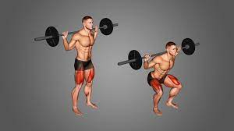
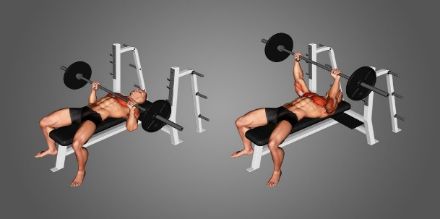
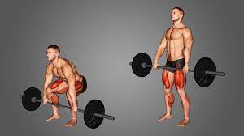
WHAT IS POWERLIFTING?
Powerlifting is a strength sport that involves three types of lifts: Squat, Bench press and Deadlift
An athlete has 3 attempts available for each lift. The heaviest successful attempt will count as the best lift.
Separate divisions based on gender, age, bodyweight and equipment

Slide 3
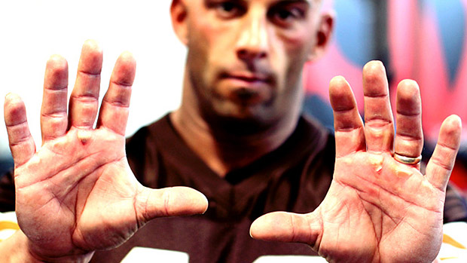
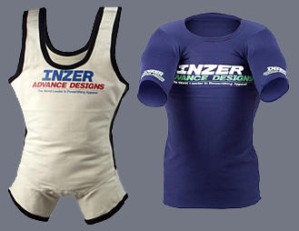
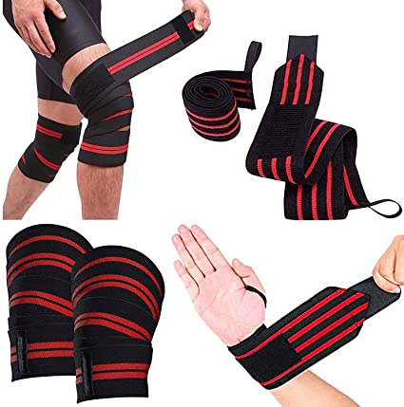
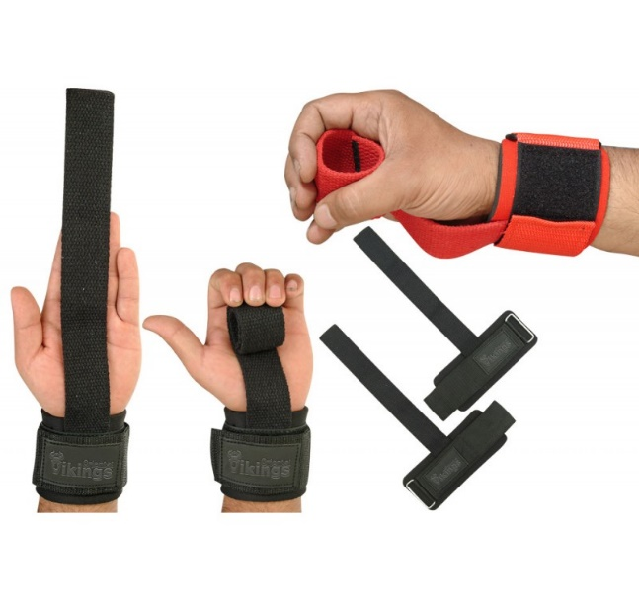
equipments
RAW
EQUIPPED
RAW
SINGLE/MULTI PLY
WRAPS
STRAPS

Slide 4
The data
Dataset provided by OpenPowerlifting
Each row contains the performance of an athlete in a specific competition
The data consists of:
Athlete: name, sex, age, weight, country
Category: equipment, age and weight
Performance: all lifts in Kg and total
Score: results in points and placement
Meeting: name, date, country and federation

Slide 5
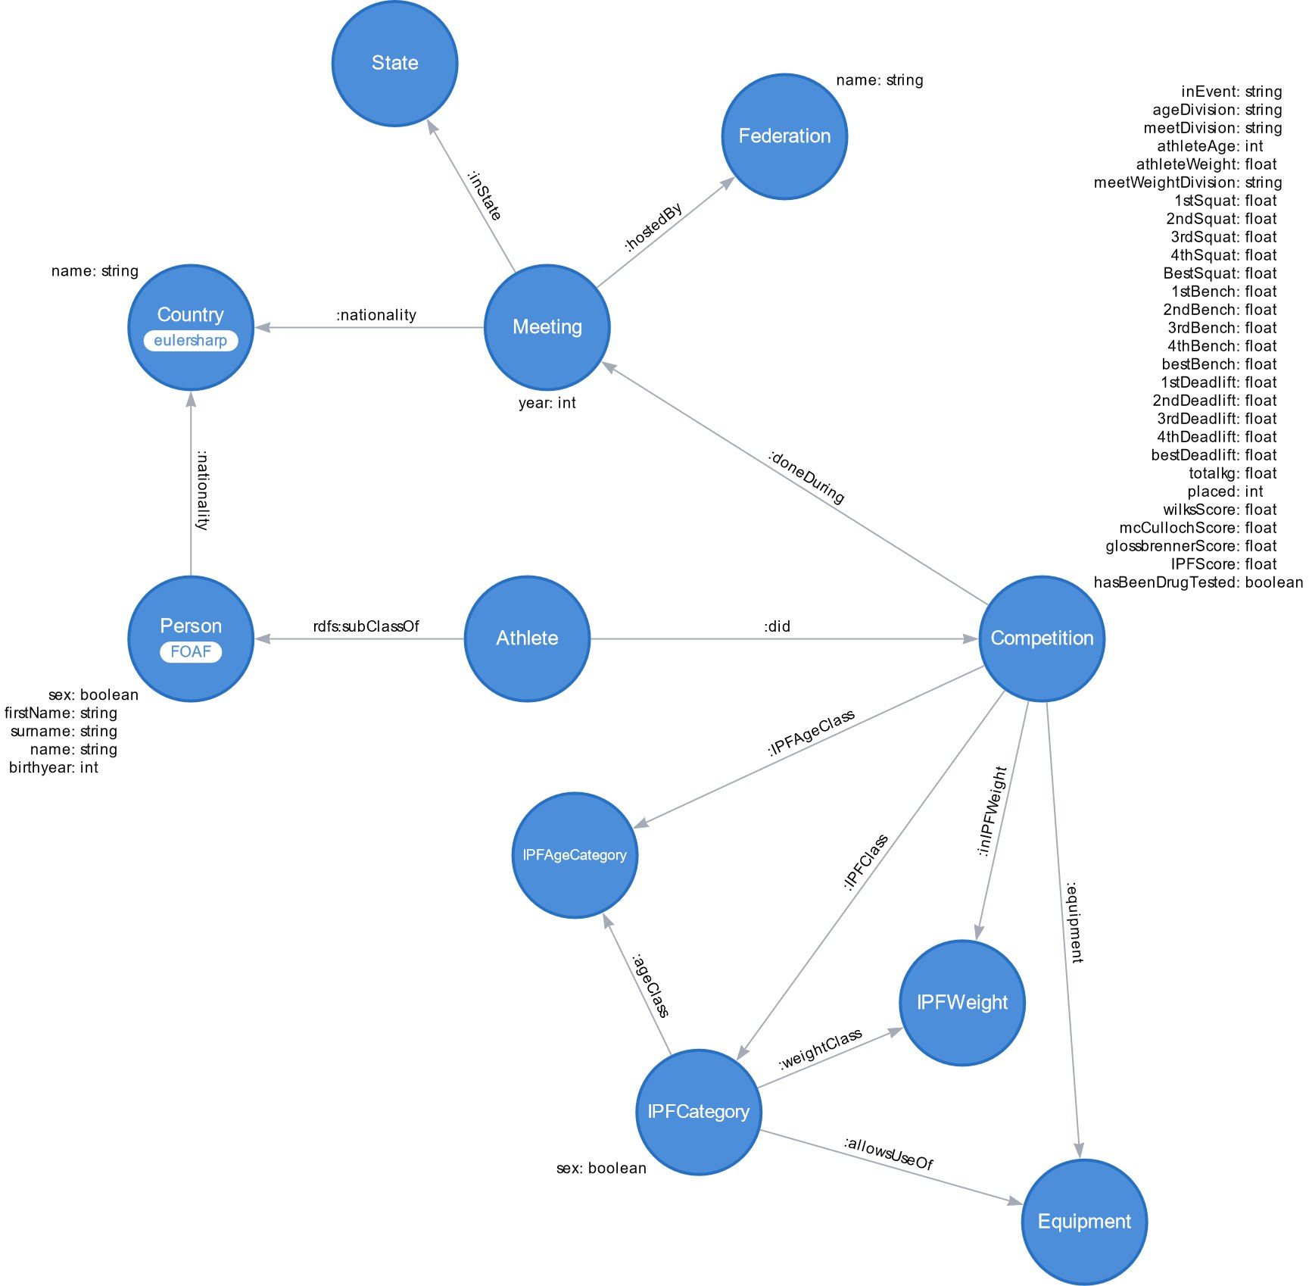
The model

Slide 6
DATA PROCESSING
Handling all the null values and special characters in the data
Handling omonym athletes
Assignment of the corresponding IPF category to each performance (when possible), depending on existent or inferrable data

Slide 7
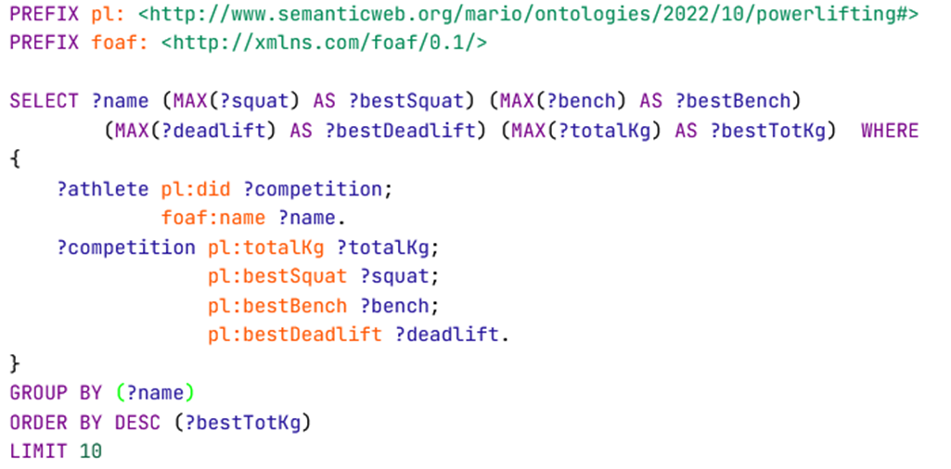
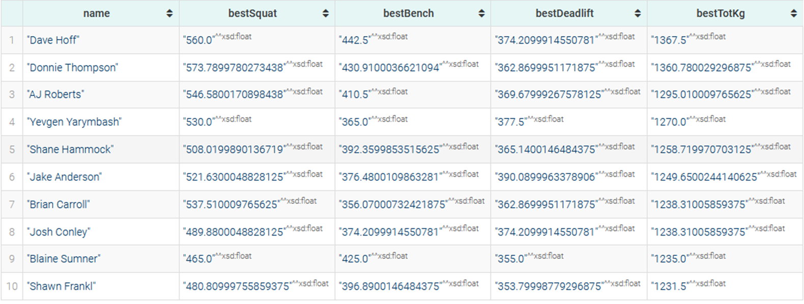
QUERY: personal bests per athlete

Slide 8
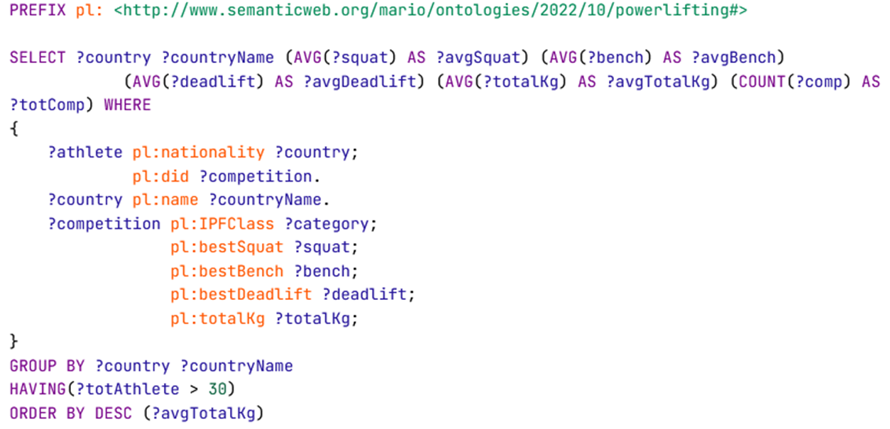
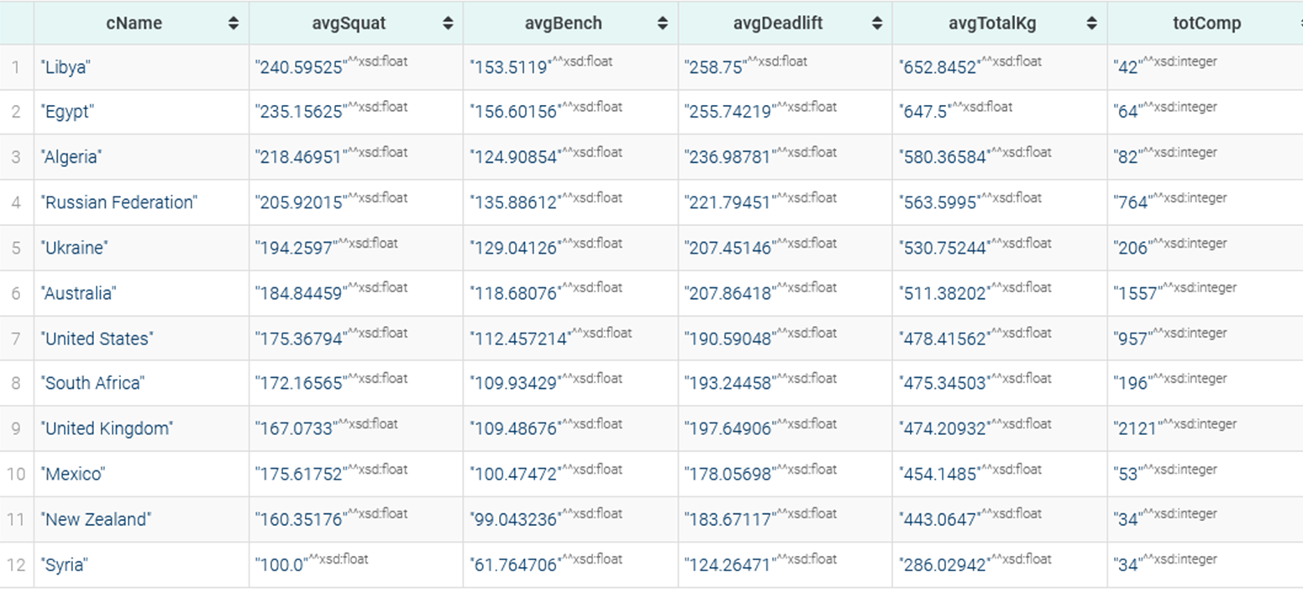
AVERAGE LIFT PER COUNTRY

Slide 9
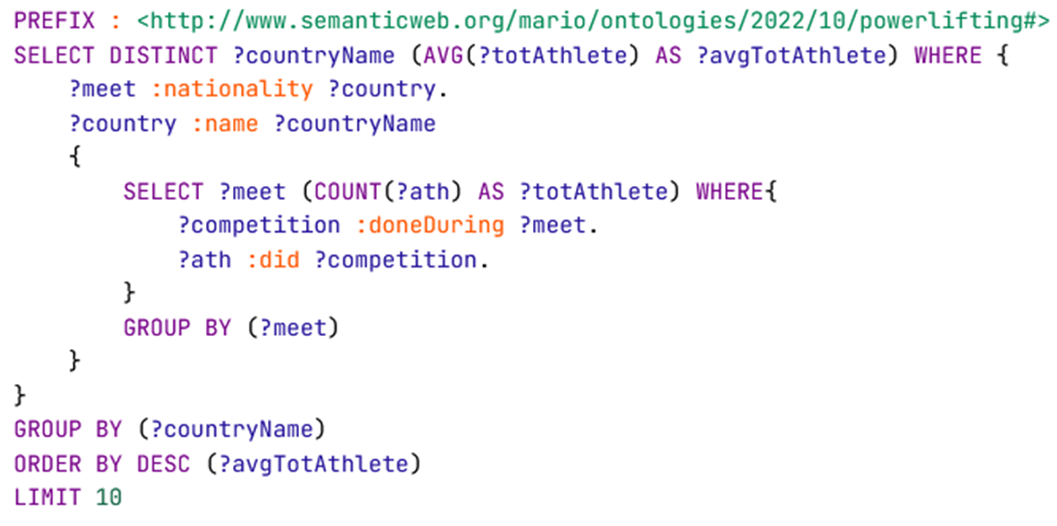
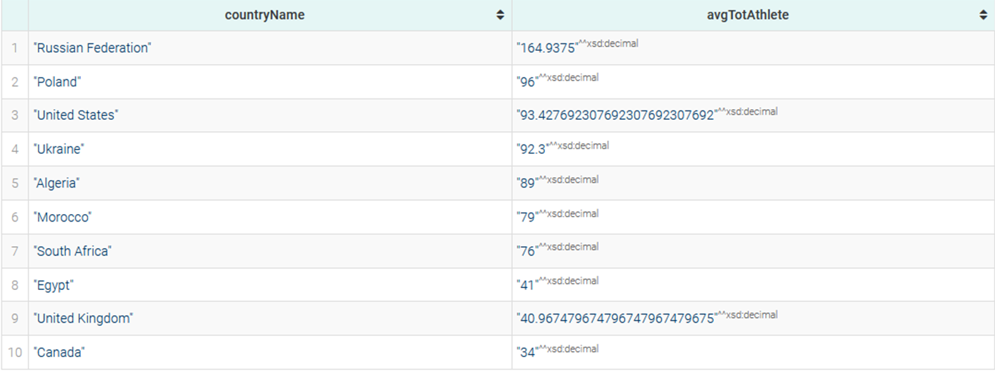
Average number of athletes in a meeting per country

Slide 10
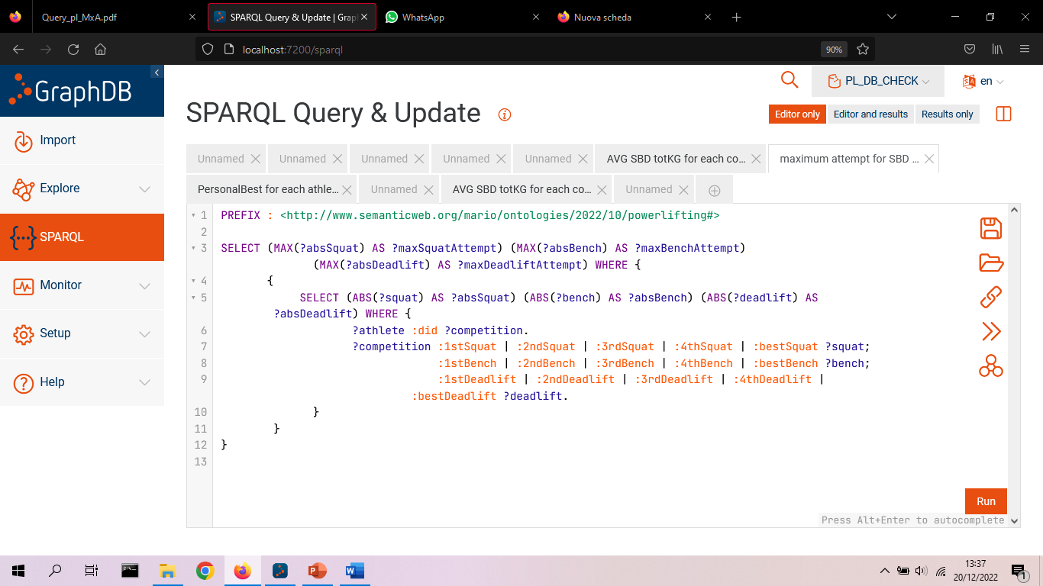
Heaviest lifts ever attempted

Slide 11
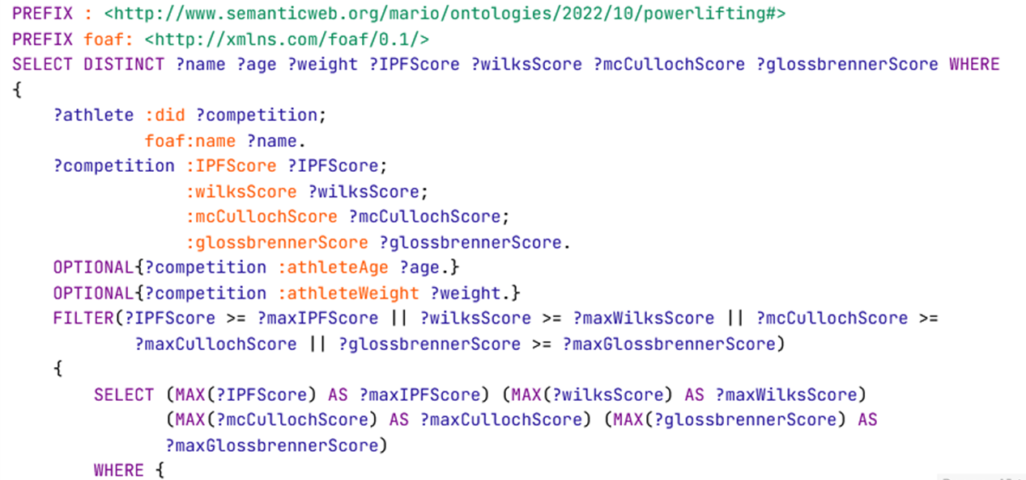

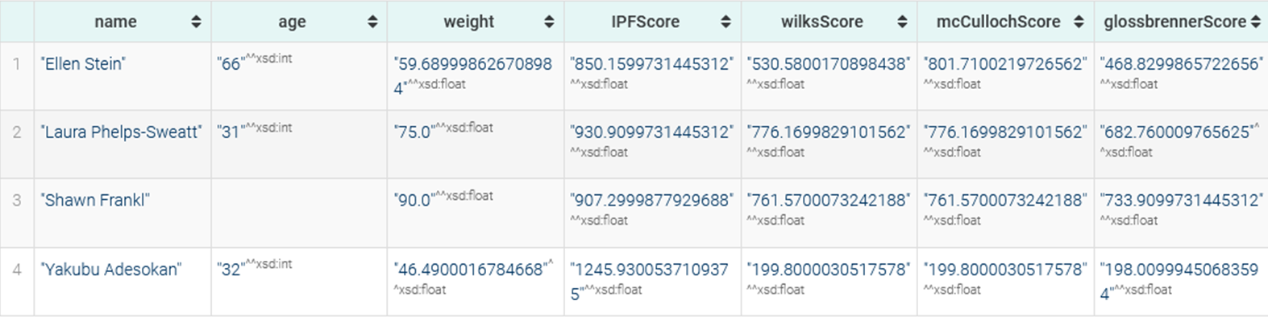
Athletes with the highest score in a competition

Slide 12
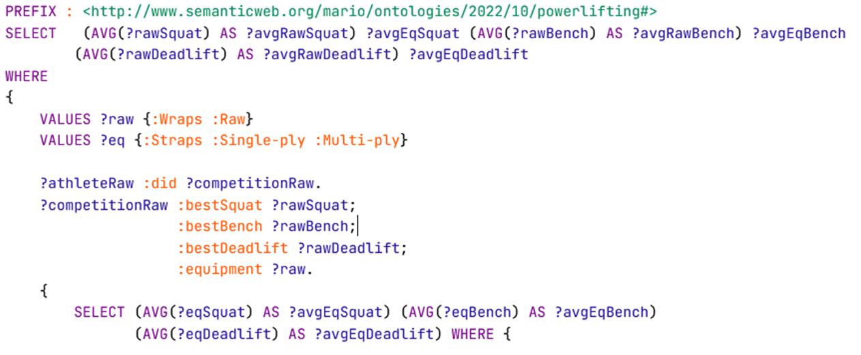
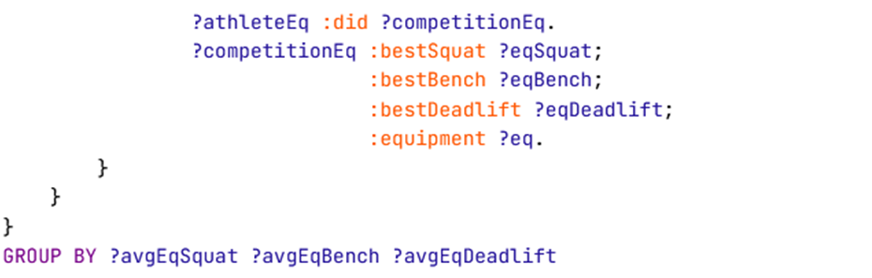
Average lifts for both equipped and raw

